Slide 1
Sourcing: Concepts and Terminology
August, 2013

Slide 2
Sourcing Concepts/Terms
In this presentation we cover important Sourcing concepts, and terminology that spans multiple features.

Slide 3
RFx
The most important feature of Sourcing is the “RFx” capability, including:
RFI: Request for Information, usually for qualification of suppliers before RFQ
RFQ: Request for Quotation, where bidding on items occurs
RFP: Request for Proposal (combined RFI and RFQ)
The others, sometimes considered to be part of RFx, are the following:
Buyer Survey: internal survey sent to members of buyer organization
Reverse (English) Auction: real-time auction where suppliers bid against each other, reducing bids until the close
Forward (English) Auction: real-time auction usually held to let buyers sell unused inventory back to suppliers (suppliers increase bids until the close)
Reverse Dutch Auction: real-time auction where price starts low and rises; suppliers submit bids, with (usually) the first bid winning
Instances of the above are called Events; the buyer running them is the Host

Slide 4
Organizations
There are three types of “organizations” in Sourcing:
When Sourcing is installed, two System Organizations are created:
emptoris: contains automatic messaging
emptoris_hierarchy: contains messages and currency tables
Do not create your own organizations with these names (SSM-Sourcing synchronization will fail).
Buyer Organizations (Sourcing Groups) – buyers of commodities / services
Suppliers – providers of commodities / services
Buyer Organizations and Suppliers are created in SSM as (often) a hierarchy of a parent and multiple levels of children; automatically propagated to Sourcing.
Buyer Organization’s Status must be set to Active for it to be fully usable
Login to Sourcing as Content Manager; manage the emptoris_hierarchy organization
Organization > View Organization > click on link for the new Organization
Set currency management level and Primary Currency (can’t be changed later)
Set Status to Active and Save

Slide 5
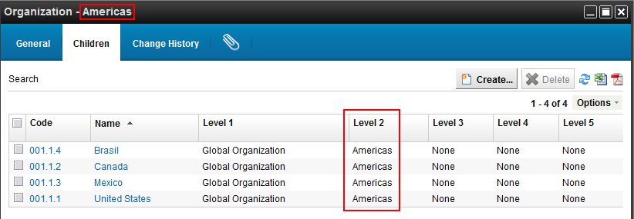
Organizations, cont.
As of V9.5, all new buyer organizations are “Full Service” (previously they could be “Self Service”).
Organizations in Sourcing represent buying entities; anything from an entire corporation down to any procurement group within it. So one Sourcing customer could have a hierarchy of many different organizations defined for it.
A Business Unit in Sourcing is a group within a buyer organization. In SSM it is referred to as a Child Organization.
When viewing an organization’s children in SSM (Children tab), Levels 1 to 5 show the organization being viewed plus any higher-level organizations.

Slide 6
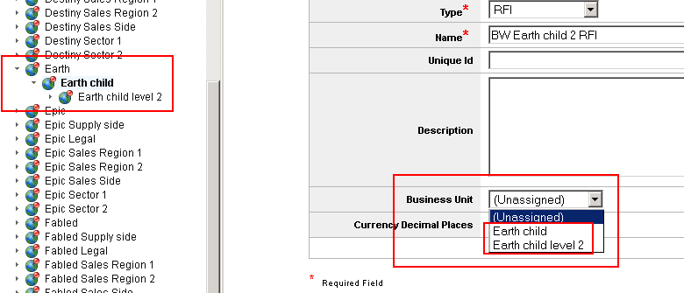
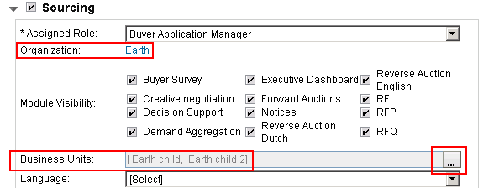
More about Business Units
In SSM, create a child organization for use as a Sourcing Business Unit as follows:
Open the parent Organization, click on Children tab, click on Create, …, Save.
Repeat as needed to establish required hierarchy of Business Units
See Earth, “Earth child”, and “Earth child level 2” at left of screen below (from SSM)
In SSM (user profile, Applications tab), a user can be associated with Business Units by first assigning a Role and Organization and saving, then opening the Business Units menu. See below right.
In Sourcing, only top-level organizations appear in View Organizations. Before use, they must be selected and Activated (Status change from Inactive to Active).
Business Units (children) are activated automatically when parent is. New Business Units are immediately active if parent was already active.
The only place where Business Units appear in Sourcing is in RFx headers. When creating an RFx, you can choose Business Unit from menu shown in middle below, which is populated with all Business Units below the RFx creator’s organization. Business Unit cannot be changed once set.

Slide 7
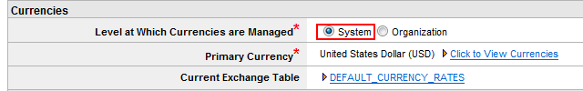
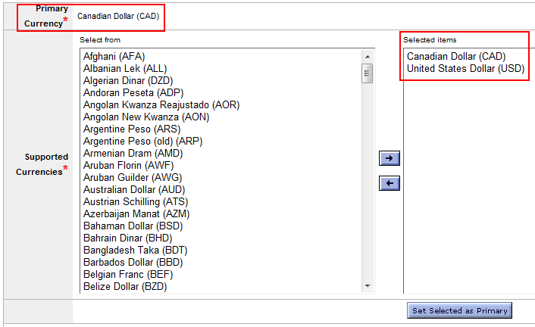
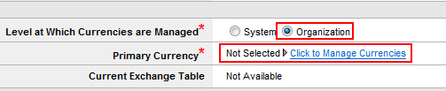
Currencies
Supported currencies, default Primary Currency, and currency exchange rate table(s) are established when Emptoris is installed and configured
For a given Organization, currencies can use the System settings or be managed at an Organization level.
However, an Organization must always support the system’s primary currency.

Slide 8
Currencies in Practice
When configuring Sourcing, the implementers should eliminate all but the needed currencies, to simplify buyers’ jobs when choosing a currency.
Given that currency exchange rates can vary by 1% or more per day, how should this be handled?
Suggestion is to update exchange rate tables monthly.
For a specific Sourcing event, exchange rates can usually be treated as static, given that most events are over within 2-3 weeks.
The handling of currency fluctuations can be covered in the contract.
If this area is of concern to the customer, the suggestion is to run events exclusively in US dollars, and let the suppliers incur the currency risk.

Slide 9
Users, Contacts, Roles
An Emptoris User is a “person” who can log in to the system
Multiple concurrent logins can occur for one user, but can be interactions if from same client system when same browser is used (due to cookie usage)
No concept of a Group (of users) in Sourcing, unlike Contract Management
Each Emptoris user is defined in SSM and assigned a Type, which can’t be changed later. Type can be:
Internal User (for Sourcing: member of a Buyer Organization)
External User (for Sourcing: member of a Supplier company)
Contact (internal or external; can get emails from Emptoris but not log in); Contacts are not used in Sourcing, except in a different sense: an RFx is assigned a Primary Contact, who is the Buyer team User for suppliers to contact about the event
User Profile: Applications tab contains settings for Sourcing Homepage, Roles, …
User’s Role can be changed (in VSM, but only by an Admin, and only if it was an organization-related role as opposed to a system role: see later). Only one Role is in effect at a time (not cumulative).

Slide 10
Users, Contacts, Roles, cont.
There are two aspects of Roles in Sourcing:
System roles (set in User Profile; see next slide)
Buyer Team roles in the context of a specific Event:
Lead / Host (abbreviated as L): creator of the event; has full permissions
Member / Co-host (M): same permissions as Lead, except can’t schedule open or close
Observer (O): can only monitor the event
Scoring Member (SM): edit/delete event, invite suppliers and buyers, plus what SO allows
Scoring Observer (SO): score or monitor the event
User sees different menus and has different capabilities, depending on what Role is in effect in each of the above aspects
There are also VSM roles for users, of which Administrator, Data Steward, and Category Administrator are particularly pertinent to setting up VSM for Sourcing.
~15 VSM roles specific to Sourcing, such as “Sourcing Content Manager”, provide the VSM permissions needed for VSM tasks (Create User, etc.), that the role had via permissions in Sourcing prior to VSM being introduced.

Slide 11
Roles, cont.
Sourcing supplies a number of Roles, although they might not all be configured in a particular system. There is no way to create custom roles, but the supplied set evolved from customer usage and has proven to satisfy virtually all needs.
One Role can be assigned at a time, in the user record’s Applications tab in VSM (only by Admin).
Details on the most important roles are on the next slide. For others, see the Buyer User Guide.
Buyer Organization roles:
Content Manager (*)
Corporate Sourcing Manager (*)
Divisional Sourcing Manager (*)
Event Manager (*)
Business Unit Manager
Buyer Observer
Key Commodity Manager
Buyer Agents
Buyer Application Managers
Organizational Supplier Manager
Supplier Organization roles:
Supplier Application Managers
Supplier Agents
(*) If this role is picked for the user: (1) an Organization cannot be chosen (because, by definition, the role spans Organizations); and (2) the role can’t be changed (so be careful!). When one of the other roles is picked, an Organization must be chosen.

Slide 12
Roles, cont.
We now look at some of the capabilities and responsibilities of some of the key roles.
The following four roles are not tied to a specific organization:
Content Manager – has the “highest” set of permissions (but can’t do everything)
Manage the catalog.
Create and manage RFx templates.
Manage supplier profiles.
Link supplier profiles to categories.
Assign reporting role to users.
Corporate Sourcing Manager (CSM) – a level down from Content Manager
View all internal (non-system) organizations in the application.
Manage buyer organizations.
Assign internal organizations to divisional sourcing managers.
… plus everything for a Divisional Sourcing Manager, primarily creating and managing RFx(s)
Divisional Sourcing Manager (DSM) – a level down from CSM
Manages assigned sourcing groups
Adds Items (products) to the Category Manager of assigned sourcing groups.
Acts as a Buyer Application Manager (BAM) for assigned sourcing groups
(Use Organization > “Choose Customer to Manage” to switch to a different organization)
Event Manager
Responsible for running events across different buyer groups

Slide 13
Roles, cont.
More roles. These (and the remaining ones not shown here) are tied to a specific organization.
Buyer Application Manager (BAM)
Create, edit, and view RFx(s) within the buyer organizations to which the BAM is implicitly invited as a lead
Link supplier profiles to categories
Buyer Agent
Create RFx(s)
View and edit RFx(s) that they are invited to
Business Unit Manager (BUM)
Create RFx(s)
View and edit RFx(s) of business units that they are associated with and are implicitly invited to as a lead
For the capabilities of the remaining Roles, see the “Users” topic in the Buyer User Guide.

Slide 14
Security
It is beyond the scope of this workshop to discuss configuration related to security. The topic is a key part of a Sourcing configuration workshop during deployment planning.
From a user’s point of view, security in Sourcing operates implicitly. It almost completely revolves around Roles and Organizations. There are two security dimensions to each Role:
Permissions
Visibility
Most of the specifics for various roles were shown on the previous slides. E.g., for BAM, these bullets summarize things:
Permissions: Create all events, perform most administrative functions
Visibility: See all events, subject to discussion below
Buyer organizations are “siloed”, so BAM users can see all events only within the Sourcing organization he/she belongs to, plus any in Business Units under that organization.
CSM (Corporate Sourcing Manager) users can “parachute into” any buyer organization, and then act as a BAM user within that organization.

Slide 15
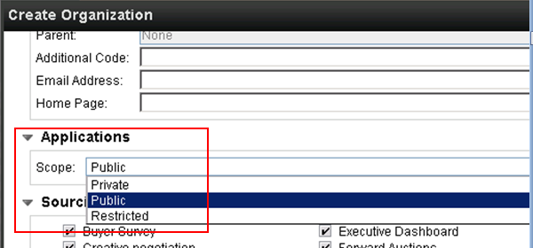
Organizations and Users as of V10.0.1
Changes were made in V10.0.1 regarding how Organizations and Users relate:
Internal Organizations have a Scope of Private, Public, or Restricted.
Private: organization is only for SSM
Public: organization is synched to all installed Emptoris SSM applications
Restricted: organization can only be used with specific SSM application(s)
A user can now be in one Organization for Sourcing, and different one(s) for other applications.
Once a user is assigned to an organization in Sourcing, org cannot be changed

Slide 16
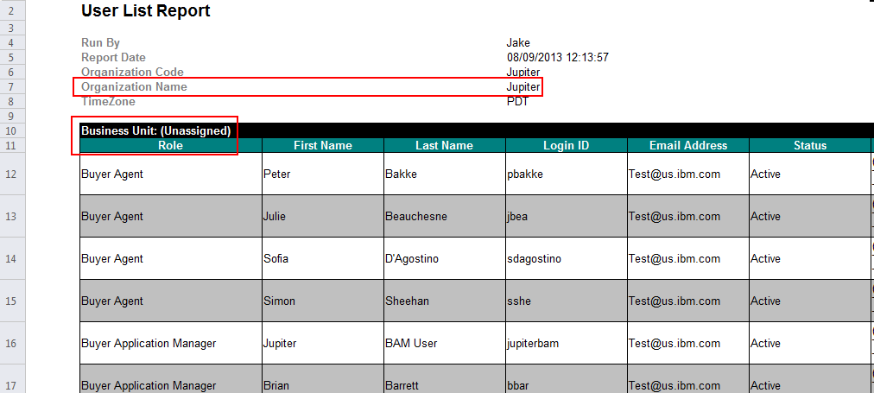
Demonstration / Exercise in VSM:
Login as Admin user
Show Organizations
Show VSM Roles by looking at Admin user profile
Show Users; create one and focus on Roles, Applications, Preferences
Show Suppliers; Show Categories
Show E-mails or Inbox (useful when email system isn’t set up, as on training system)
In Sourcing: To get a report showing users and their roles within an Organization and/or its Business Units, you can use Utilities > Reports > Standard Reports > User Reports > User List Report. Business Unit = “(Unassigned)” indicates the top, or Organization, level.

Slide 17
Suppliers
Suppliers have many properties in common with Organizations, but represent external entities and are managed differently in both SSM/VSM and Sourcing
Emptoris Supplier Lifecycle Management (SLM) provides the highest degree of capability for managing Suppliers, but SSM/VSM on its own provides sufficient Supplier functionality for Sourcing
Suppliers can optionally be Mastered (via Closest Matches tab in VSM record)
Mastering is the creation of a “golden record” that has been established from among possible duplicate records for the same Supplier. When a Supplier has been mastered, it has a “Master ID” in VSM (seen as “VSM ID” in Sourcing).
It is not necessary to Master a Supplier for it to appear in Sourcing.
Suppliers may need to agree to a Non-Disclosure Agreement (NDA) when signing in. This is to prevent them from sharing information with other buyers and suppliers.
Before a Supplier (company or group) can bid on events, it must be Approved in VSM. This causes the Supplier’s Status (under “Approval Status”) in Sourcing to change from Inactive to Active. (Note that for Organizations, this step is done in Sourcing, as described earlier.)
Suppliers (staff) must be defined as External Users in SSM for them to be able to log in to Emptoris Sourcing and respond to events.
Supplier Tutorials and the Supplier User Guide provide instructions on how they use Sourcing

Slide 18
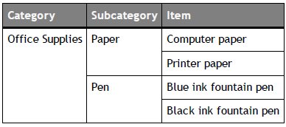
Catalog, Categories, Items
The Catalog is a hierarchical system of the following:
Categories: high-level groupings of products to be sourced
Subcategories: children of categories
Items: the actual products
The Catalog can have an unlimited number of categories and subcategories.
The bottom level always contains items.
Categories and subcategories are managed in VSM (Categories > Master) and are normally created through batch uploads. Items are managed in Sourcing (Categories link).
Example:

Slide 19
Questionnaires, Questions
An RFI, RFP, or Buyer Survey contains Questionnaires.
A Questionnaire is a group of related Questions that seek to gather feedback from Suppliers (or about them, in the case of a Buyer Survey).
Questionnaires might address general company information, financial information, customer support, references, adherence to standards, etc.
Questionnaires and Questions must be assigned a relative Importance value of 0.00 to 10.0 (10.0 is most important). These are used in scoring.
Questionnaires are typically linked to Categories, which allows you to quickly identify and select suppliers which have approved links to the category.
Showstopper: Questionnaire or question can be designated as a showstopper, meaning that if response(s) don’t meet minimum value, it will be flagged. It does NOT mean that the Supplier is automatically excluded from consideration. Not often used in practice, because it’s rare to deal strictly in black and white.
(More details in RFI presentation)

Slide 20
Scoring, Autoscoring
Scoring of an RFI or RFP allows quantitative evaluation of responses
Questions can have numerous types of responses, such as selection from a list, in a table, Yes/No, or single values of various data types (Date, Currency, Text, …)
Text responses can be validated vs. a specific pattern (e.g., email, zip code)
Manual scoring is required for questions with Date, Table, or Text answers; for these, buyer reads response and assigns a score manually
Autoscoring can be done for questions with all other types of answers; you provide mapping of responses to a score ranging from 0 to 100 for each question; e.g., Yes → 100, No → 0.
Importance values of questionnaires and questions are also factored in to yield an overall score for each supplier’s response

Slide 21
Event Status Values
The following are the possible Status values for an Event, in their usual sequence:
Created: Equivalent to a document draft. The basic setup has been completed, there may be items placed in the RFx but right now it is sitting dormant; it does not have any associated open/close dates.
Pending Invitation: Event has been scheduled but the invitations have not been distributed. Usually this occurs when Manual Distribution is selected for the event notifications.
Pending: Event is scheduled but has not reached its open date and time.
Open: Event is in progress: has reached its open date and time, and can’t be edited.
Paused: The host has paused the Auction. It is temporarily unavailable for accepting bids. This does not apply to RFx(s).
Closed: The scheduled close date has been reached or the host has manually closed the RFx. It is no longer available for accepting bids.
Awarded: The host has awarded the RFx.
Cancelled: The host has cancelled the RFx. It can’t be “uncancelled”.
It is also possible for events to be Archived. This is a very rarely used feature, but, typically, events would be archived after 3-5 years (via a property file setting). Such events could be found on the Archived tab of Manage RFx(s), and restored if needed. They would not appear on the List tab, even with a filter of All.

Slide 22
RFx Templates
An RFx Template contains information used as a starting point for RFx creation.
No OOTB templates are supplied with Sourcing (generic ones have little value)
Templates can be handy if you repeatedly work with the same suppliers or use similar settings for different RFx(s). However, there is no security on templates, so a buyer that can see one can see all; if this is an issue, you might want to export model RFx’s to a secure disk and use Import to create new RFx’s from there.
The following information is reused when you create an RFx from a template.
Currency information
RFx Rules
Questionnaires
Items
Bid fields
Supplier list
Team members
Attachments

Slide 23
RFx Templates: Operations
The following operations can be performed for RFx Templates:
Create an RFx from a Template
Create a Template from an RFx (Edit tab Summary step in Wizard)
Create a Template from another Template (already in the system)
Create a Template from scratch (like a partial RFx creation)
Export and Import Templates
XML, CSV, and XLS/XLSX formats can be used; Excel is recommended
A lot of guidance is provided in the exported spreadsheet
As an example, you can export from one organization, change the organization code and other details in the file, and import into a different organization

Slide 24
Messages and Triggers
Sourcing comes with a standard set of messages, managed by the emptoris and emptoris_hierarchy organizations for all of the organizations in the system.
Also, there’s a set of triggering events defined for issuing the messages.
Triggers cannot be added or modified (there’s no need to).
For a specific Organization, a user acting under the Content Manager role can override the system messaging:
disable/enable messages
export and import (modified) messages
change message content and configuration (recipients)
To see and optionally manage messages for an Organization:
Organization > View Organization > click on Organization folder icon

Slide 25
User-Defined Property Fields
Sourcing has various types of “Fields”, used to store metadata describing entities
These field types are available (when configured): Category property, Item Definition, Bid Field, Question, RFx Information Field, Supplier Profile Field, Notice Information Field, Generic Field
Most field types have a set of instances supplied by the system
You can also create new instances of fields (requiring SSM Administrator role or Sourcing Content Manager or BAM role)
These field data types are available: Text, Currency, Date, Decimal, Formula, Integer, Message, Selection, Spacer Row, Table, Yes/No
Fields can be stored in the Smart Data Library for reuse
See Administration presentation for more details on Fields

Slide 26
Field Types (Supplier and Buyer views)
From a Supplier access point of view, there are these types of Fields, with the choice often being part of the event design:
Supplier can’t see it (Hidden)
Supplier can only see it (Read)
Supplier can see and update it (Write)
Supplier can see and must update it (Write + Required; e.g., Bid Field)
Similar considerations apply to the Buyer view of some fields.

Slide 27
Terminology
For more detail and others, see topic “RFx Concepts” in the Buyer User Guide
Minimum and Maximum Bid Quantities:
The buyer sets the Minimum to the quantity they need, and the Maximum to what they would consider buying if offered a good price. In general they should not be set the same, to allow flexibility.
Reserved Price:
The maximum price per unit that the buyer is willing to pay for an item.
Historical (Baseline) Unit Cost:
Essentially, what the buyer is paying now for the item; used primarily to estimate cost savings possible from the various bids; can be imported
Incumbent Supplier:
The current supplier of an item. Useful to identify, in case preferential treatment is appropriate (lower risk).

Slide 28
Terminology, continued
Unit of Measure: Units applicable to quantity specified for this item. Can be by weight, volume, or many others, including simply “units”.
Delivery Date: The expected delivery date for the good/service.
Lead Days: Used if a specific date is not appropriate, but the buyer wants to know lead-time requirements for the item.
Minimum Bid Change: In an auction, the minimum amount or percentage by which a supplier’s bid can be changed from his/her previous bid; used in automatic generation of a new bid with the Take Lead and Minimum Bid Change links. Do not confuse with a Bid Cushion Limit (Lower or Upper), which prevents a leading bid from one supplier being beaten by a trivially better one (or one implausibly better) from another.

Slide 29
Other Concepts
Binders: Folder capability for grouping events
My List: Personal list of events of interest; quicker access to them is available

Slide 30
Other Features
Quick Search facility:
This is available on many Sourcing screens
Provides powerful way to find qualifying objects of different but relevant types
Enter at least two characters; it will list object names starting with those characters
E.g., when searching for Suppliers, it will find matching Supplier names or user/contact names
Click on a matched object to have it used as appropriate for the context; e.g., added to a list
Smart Data Library (SDL):
Objects such as RFI Questions and RFQ Bid Fields can be stored here and added to events (via “Library” button)
Accessed via Utilities menu
Requires Content Manager role to add objects to it
Not widely used in practice, because: (1) there is no Import facility to add objects in bulk; (2) customers would prefer to have entire Questionnaires (including Questions) in the SDL, but only individual Questions can be stored

Slide 31
Other Features, cont.
Data Manager:
When tasks such as import and export are performed, a Data Manager window opens to show the job running (and previous ones). It can also be opened via Utilities > Import/Export > Data Manager.
Typically you use the Refresh icon to update status until job is marked Done. Other status values can be Pending, Running, and Failed (e.g., if you try to import a text value into a numeric field).
For an export, click on the Status link to download (open or save) the file.
Sourcing Desktop Intelligence (SDI): (Excel add-in for reporting)
This provides access to a high degree of customization of RFx reports.
More on this in separate presentation.

Slide 32
Questions?

